Slide 1
Innovating Along the Learning to Earning journey
How to Empower the Next Generation
Franziska Seiffarth
Dominic Orr

Slide 2




EARNING
LEARNING
Notes:
10.40-10.45
Innovating along the learning to earning journey - “How to empower the next generation – Insight from atingi and yoma”
Our workshop will discuss the specific stages in the learning to earning journey.
We will position the work of atingi and yoma with our partners along these stages.
In the discussion part of the workshop, we hope to encourage other partners to place themselves along this journey trajectory and to discuss how we can collaborate to empower today’s youth to fully reach their potential.

Slide 3
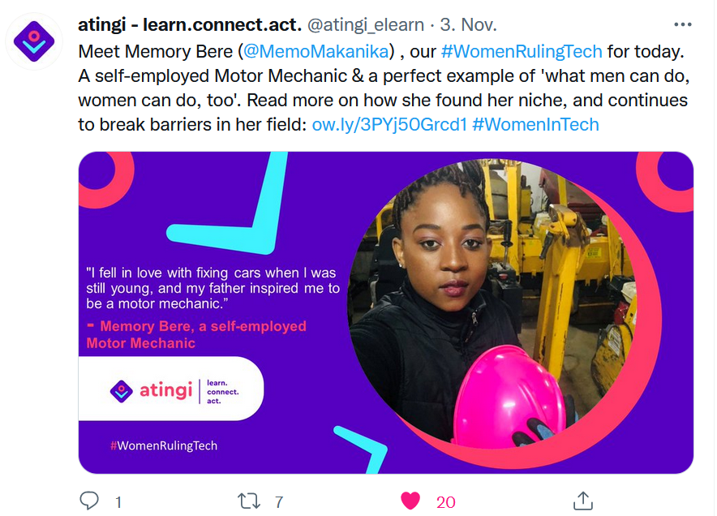

Slide 4


Slide 5


Slide 6


Slide 7
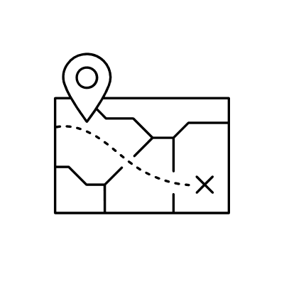
Innovating Along the Learning to Earning Journey
What are the blockers?
What are the enablers?
https://yopad.eu/p/OEB2021_learning_earning

